Slide 1

mobibench.c for mobile benchmark tool(mobibench)

Slide 2
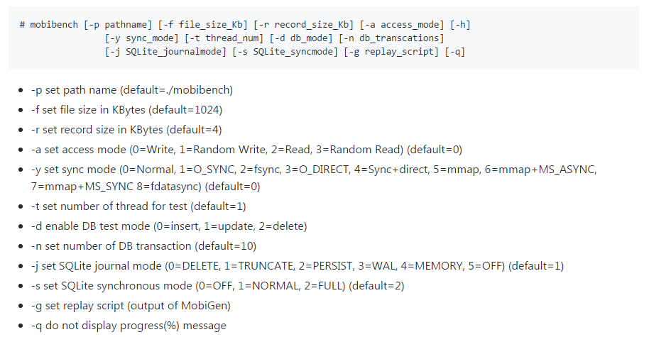
File IO benchmark
DB

Slide 3
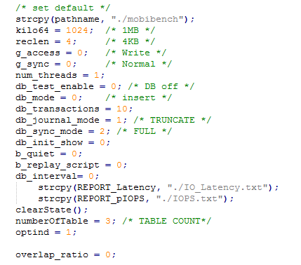
int main( int argc, char **argv)
1.参数设置
默认设置
线程状态清空

Slide 4

int main( int argc, char **argv)
1.参数设置
默认设置
线程状态清空
根据main()函数参数对参数进行具体设置

Slide 5
int main( int argc, char **argv)
1.参数设置
默认设置
线程状态清空
根据main()函数参数对参数进行具体设置
创建并打开目录，进行脚本相关设置

Slide 6
脚本设置
1.int do_script(struct script_entry* se, struct script_thread_time* st)
①完成以下操作：打开文件、关闭文件、读、写、同步、调用、检查是否可读写、信息获取、删除文件，并显示执行结果；
②计算各操作io_time；
③更新各操作的文件描述符。
2.int script_thread_main(void* arg) 各线程并行执行do_script()
3.int replay_script(void)
①打开并扫描输出的脚本文件，为各脚本条目分配空间，保存并解析脚本行，获取脚本信息； ②获取线程信息，为其他信息分配空间；
③启动（创建）线程，待完成后计算total_io_time/total_io_count/total_r/w并输出
返回io_time

Slide 7
int main( int argc, char **argv)
1.参数设置
默认设置
线程状态清空
根据main()函数参数对参数进行具体设置
创建并打开目录，进行脚本相关设置
线程数设置，多线程→参数转换
打开文件分别输出latency/IOPS

Slide 8
int main( int argc, char **argv)
2.测量设置
创建线程 DB off & DB enable
设置线程状态为READY，等待所有线程做好执行准备
启动执行测量函数cpuUsage(START_CPU_CHECK)
设置线程状态为EXEC，向所有线程发起启动信号
等待所有线程执行完成

Slide 9
int main( int argc, char **argv)
3.测量结果
cpuUsage(END_CPU_CHECK)
print_time()
1.显示执行时间及速率
2.将latency/IOPS写入文件
latency file/IOPS file

Slide 10
Filebench - A Model Based File System Workload Generator

Slide 11
allows to specify application's I/O behavior using its extensive Workload Model Language (WML).
2 different typical Filebench workflows:
①User-defined workloads (WML)
②Pre-defined workloads

Slide 12
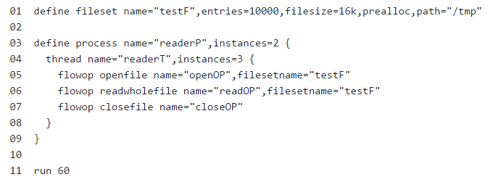
User-defined workloads (WML)
1.create the description of the workload in WML language→*.f
2.run 'filebench -f *.f' command to generate corresponding
workload

Slide 13
Pre-defined workloads←Filebench comes with several predefined micro- and macro-workloads (e.g.,webserver, fileserver, mailserver) which are also described in WML.
※ not directly use workload files←these workloads are not
properly sized (e.g., in terms of the dataset sizes) to a
particular system.

Slide 14
Pre-defined workloads
※ Filebench comes with several predefined micro- and
macro-workloads (e.g.,webserver, fileserver, mailserver)
which are also described in WML.
※ not directly use workload files←these workloads are not
properly sized (e.g., in terms of the dataset sizes) to a
particular system.

Slide 15
Pre-defined workloads
1.copy webserver workload to any other directory:
$ cp /usr/local/share/filebench/workloads/webserver.f mywebserver.f
2.edit the copied file to increase the dataset size by setting the number of files ('entries' attribute of a fileset) to an appropriate value.
3.run the workload:
$ filebench -f mywebserver.f

